Slide 1
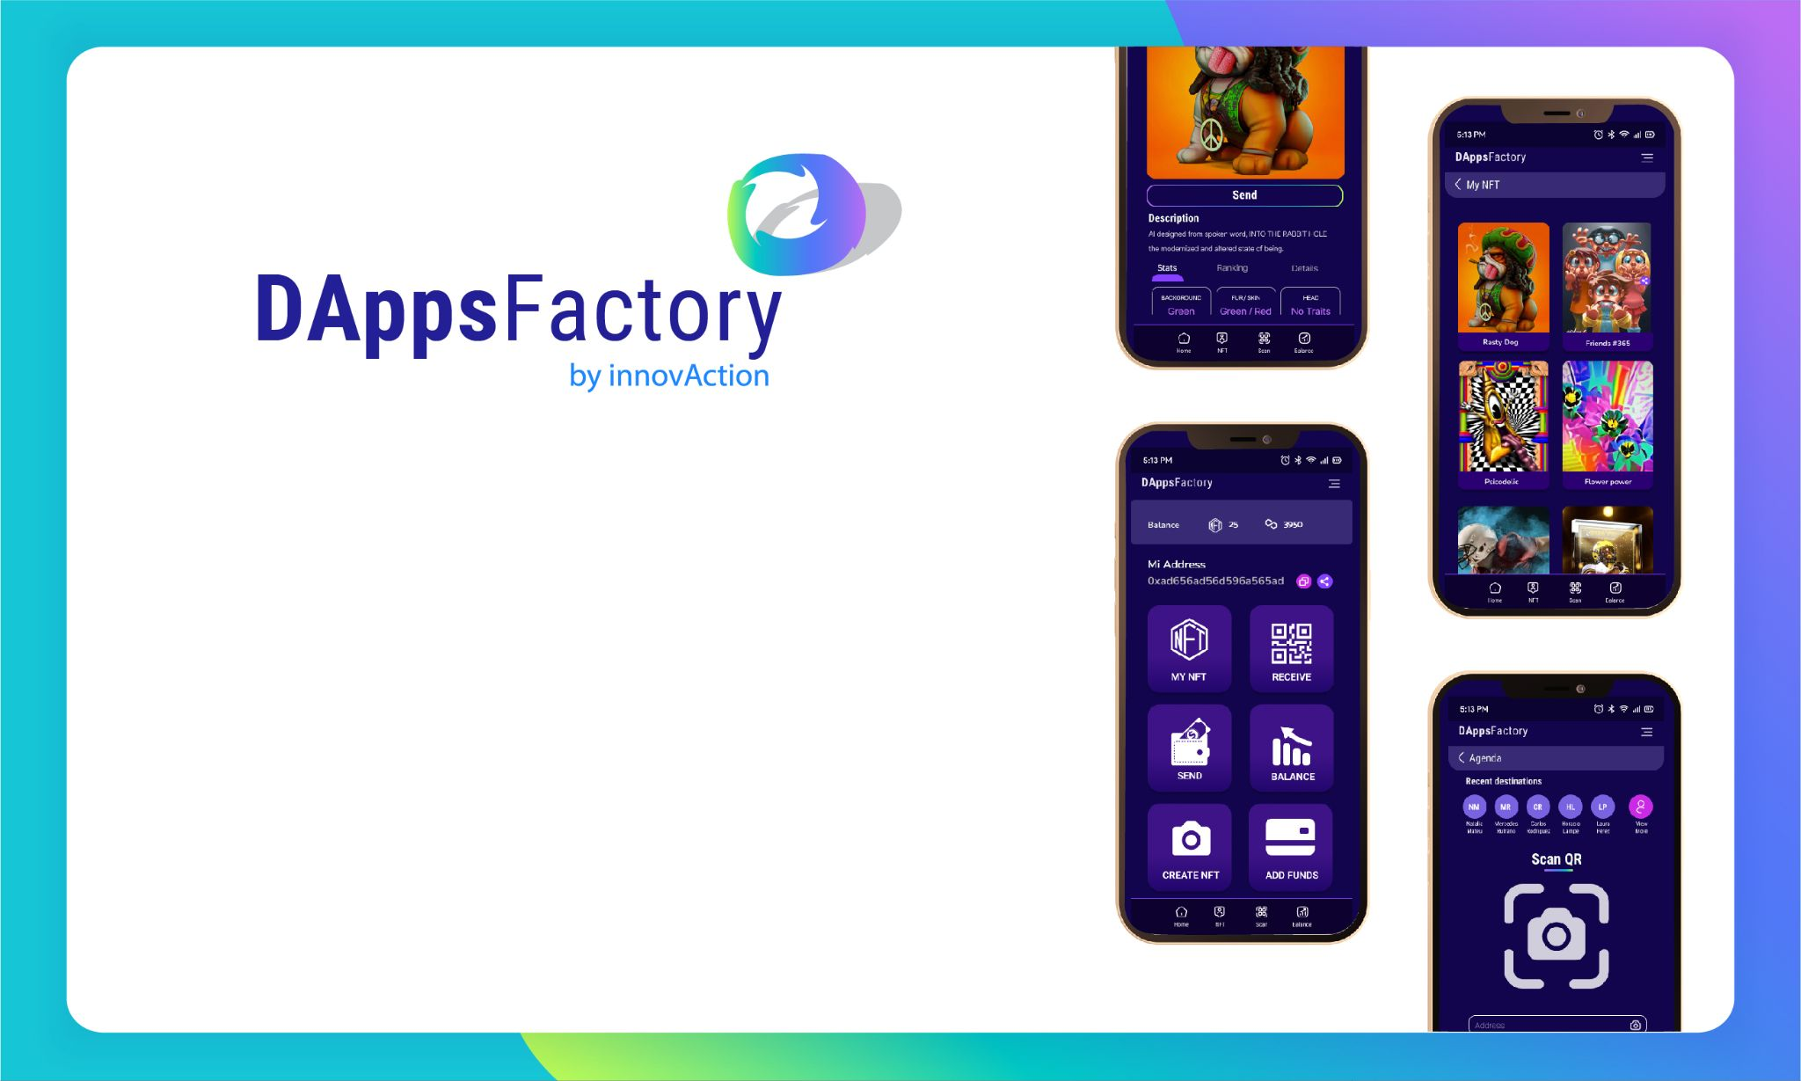

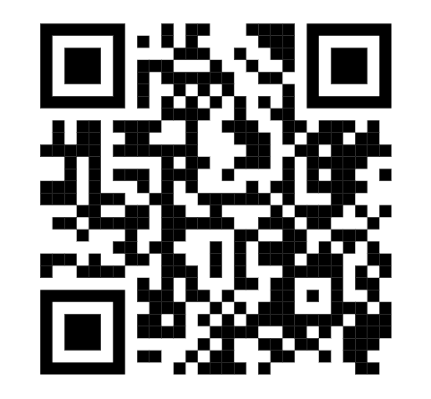
https://www.pieceofcakewallet.com/

Slide 2


PIECE OF CAKE - WALLET:
THE BRIDGE THAT FILLS THE VOID WITH ZERO FRICTION
Bridge Between The Nft World And The Real World With Zero Friction
Bridge Between The Art World And The Real World
Bridge Between Brands Promoting With Nfts And The Real World
Metaverse And Real World
Web2 Web3 Bridge

Slide 3

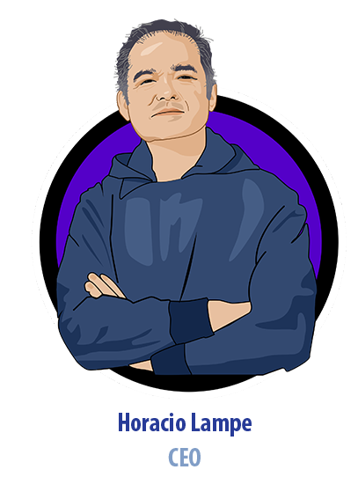
THE BRIDGE THAT FILLS THE VOID WITH ZERO FRICTION
Father of a family 40 years married, 2 children and a granddaughter.
1985 Electronic Engineer UBA with two MBA
1992 Head of Design at Siemens of the first ASIC developed in
Argentina.
2001 I left 20 years of corporate life (Siemens, Telefónica,
Movicom, Avaya).
2001 I founded my first Startup InnovAction Group (21 years
operational and counting).
2016 Created my second Startup Action Fintech (6 years and counting).
2021 With 62 years old I created my third Startup DApps Factory .
Record obtained: keeping an SME running in Argentina for more than 7 years (21 years and counting).

Slide 4
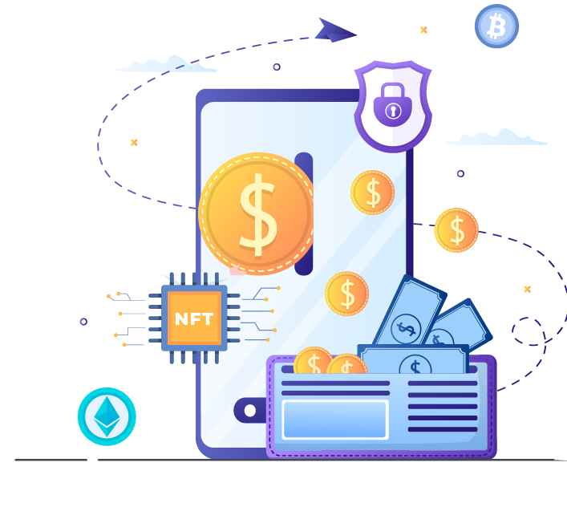
I SAW A HUGE POTENTIAL FOR GROWTH DRIVEN BY:
Very low adoption (less than 6%)
High technological potential
High FOMO
Growth of Crypto markets
Growth of NFTs

Slide 5

GENESIS OF PIECE OF
CAKE WALLET
2020 During the pandemic I got into the Blockchain ecosystem a lot.
I studied a lot of Blockchain, IDOs, ICOS, Prog. etc.
2021 Create DApps Factory
I hired 14 developers
I trained them with the best developers
Started Blockchain developments

Slide 6
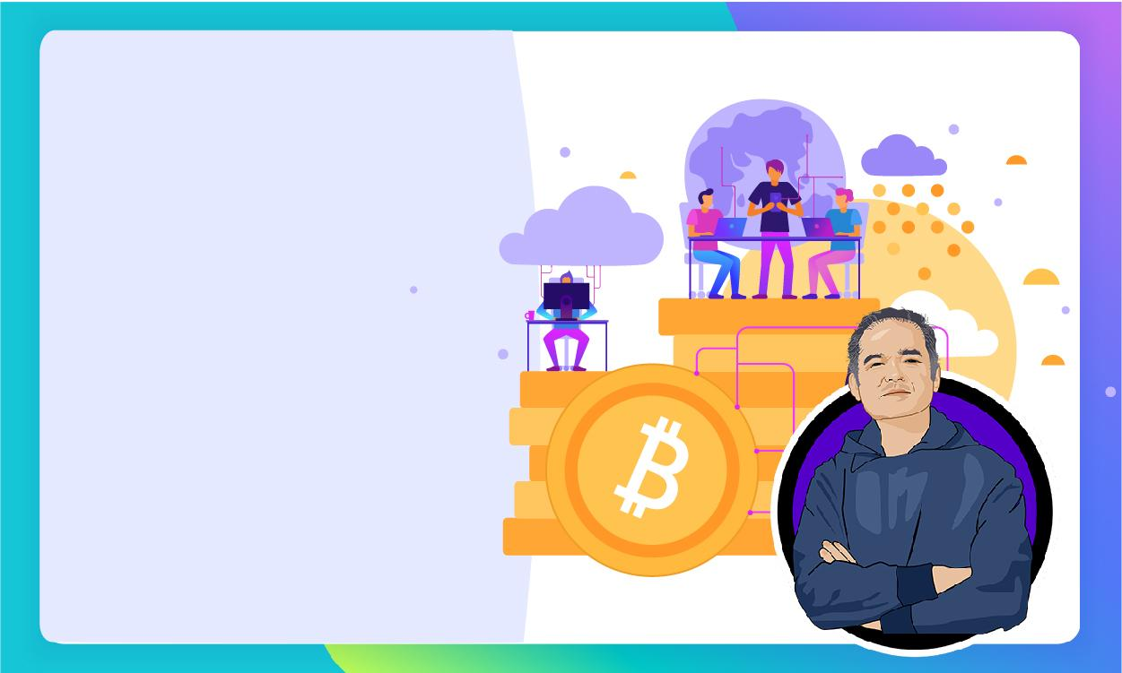
MY ILLUSION MADE ME WANT TO SHARE
WITH EVERYONE THE USE OF WEB3 TECHNOLOGY

Slide 7
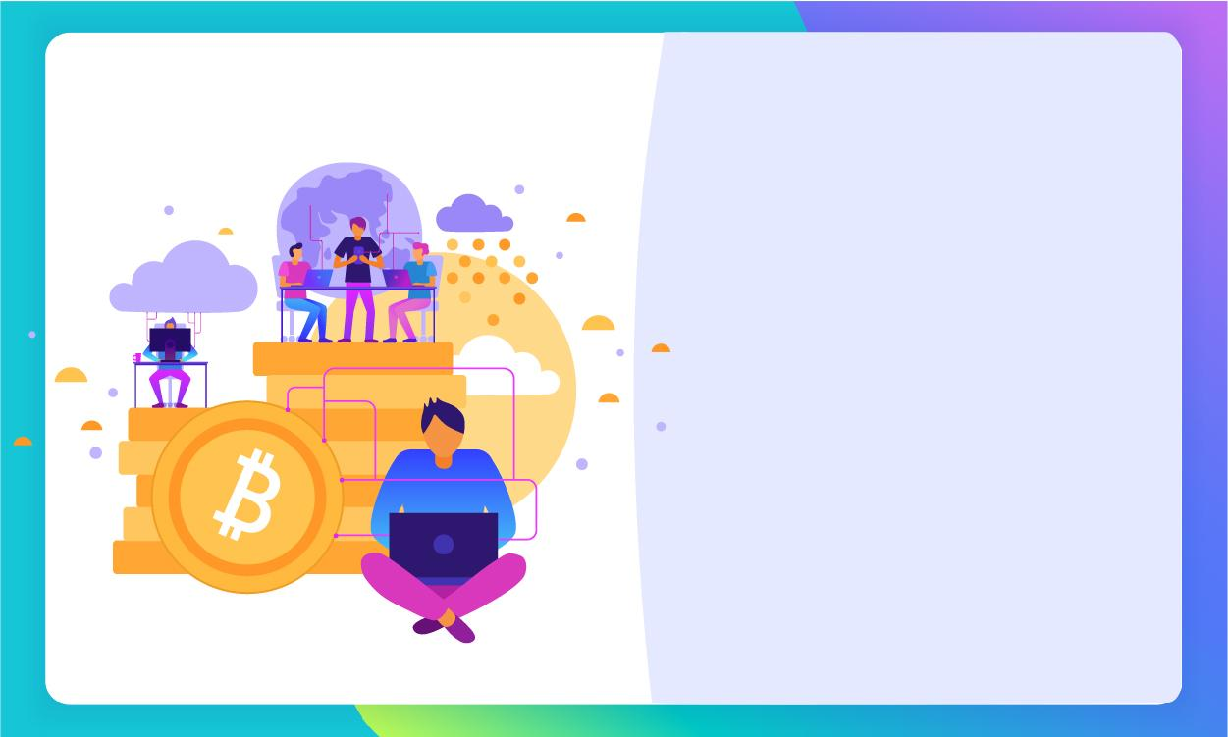
MY FIRST MAJOR
FRUSTRATION
FRUSTRATION FOR
WEB3 SHARING,
IT'S COMPLICATED ADOPTION FOR THE AVERAGE PERSON.

Slide 8
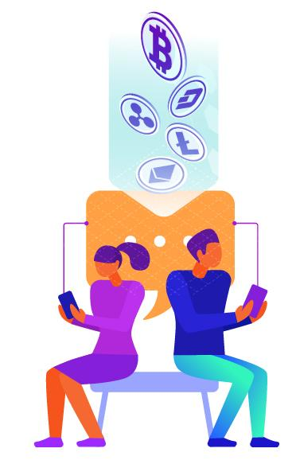
HISTORY AND PAINS - THE GREAT FRUSTRATION OF NFTS MANAGEMENT
Not being able to see my collection of NFTs in my Wallets
Not being able to share NFTS with people who don't have wallets
My wife and aunt do not understand and do not have wallets.
Wallets tend to be complex and confusing (they are not friendly)
Lots of friction from web 2
I could not generate NFTS from my cell phone.
I could not share information massively through NFTS
I saw the limitation for common people to access the metaverse and
wearables.
I could not register unique places and moments in the Blockchain.
Difficulty for Fiat on Ramp for NFTS purchase.

Slide 9
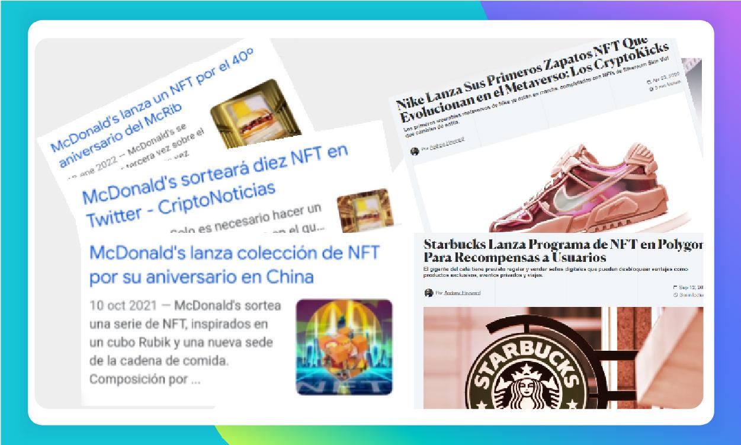

Slide 10
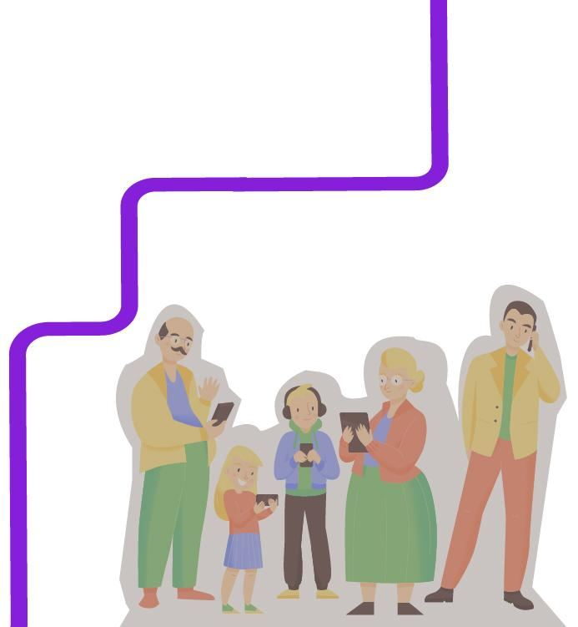
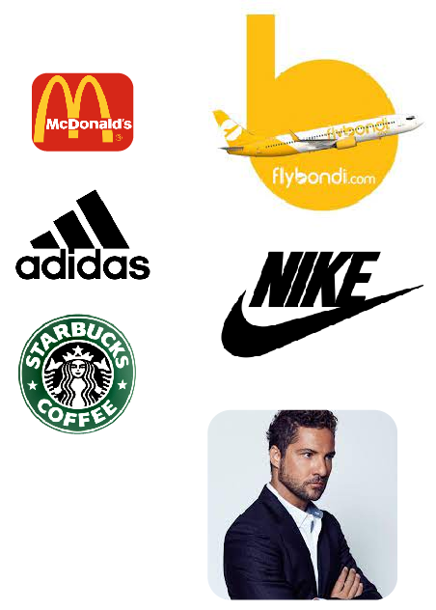
MAJOR BRANDS, ARTISTS AND AIRLINES LAUNCH
NFTS CAMPAIGNS
Web3
BLOCKCHAIN
NFTS
Real World

Slide 11
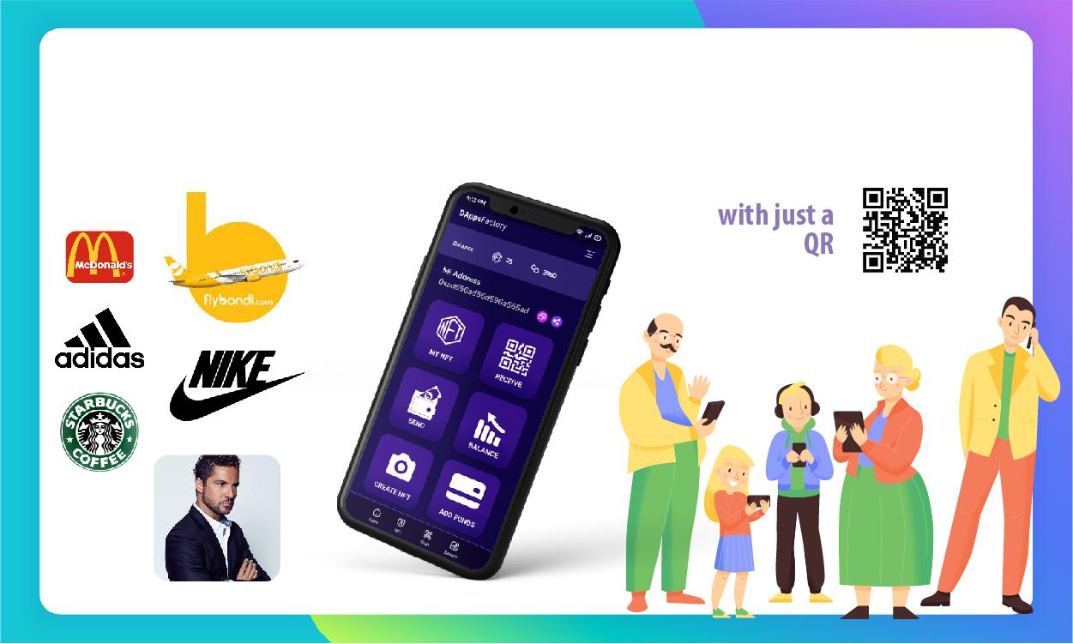
PIECE OF CAKE WALLET - BRIDGE BETWEEN THE WORLD
NFT AND THE REAL WORLD WITH ZERO FRICTION

Slide 12
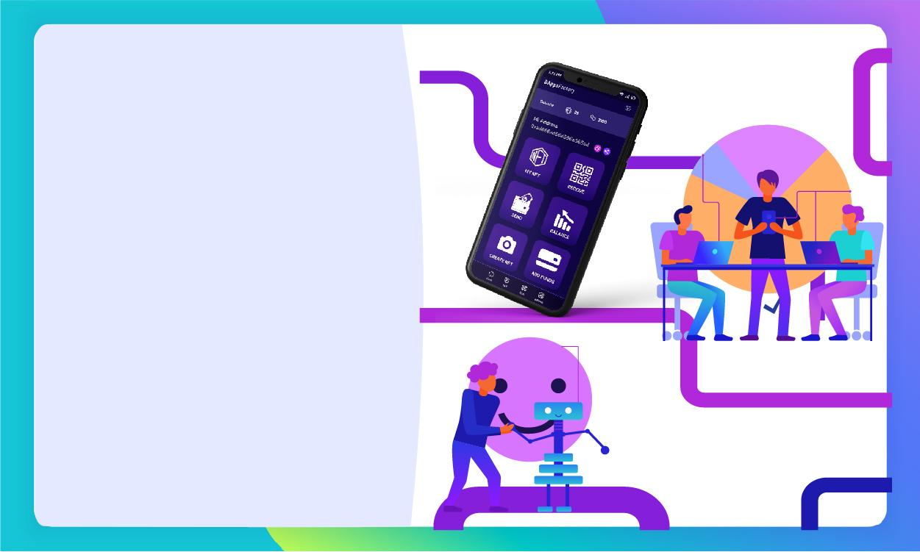
A BRIDGE BETWEEN A WEB2 WITH WEB3,
WITHOUT THE NEED FOR PEOPLE TO REALIZE THAT THEY ARE CROSSING IT.

Slide 13
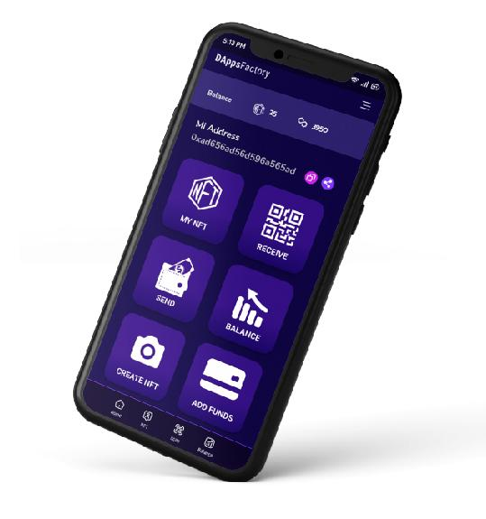
PREMISES FOR THE DEVELOPMENT OF A WALLET THAT:
No need to remember new passwords
Log in with Google, Facebook, Instagram, Metamask, etc.
Self-custodial or not custodial
It can be viralized simply by sending emails or NFTS
Can be generated as a SaaS SERVICE
Can be white label to serve large Corporate Brands
Corporate
It should be an APP that works on WEB and Cellular and without the need to download it from the Google Play Store or Apple Store.
NFTS Market Place and secondary markets

Slide 14

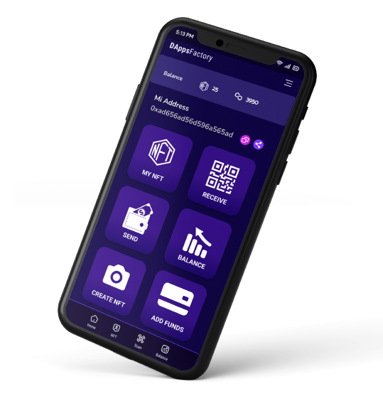
No need to remember new passwords
Log in with Google, Facebook, Instagram, Metamask, etc.
Self-custodial or not custodial
It can be viralized simply by sending emails or NFTS
Can be generated as a SaaS SERVICE
Can be white label to serve large Corporate Brands
Corporate
It should be an APP that works on WEB and Cellular and without the need to download it from the Google Play Store or Apple Store.
NFTS Market Place and secondary markets

Slide 15
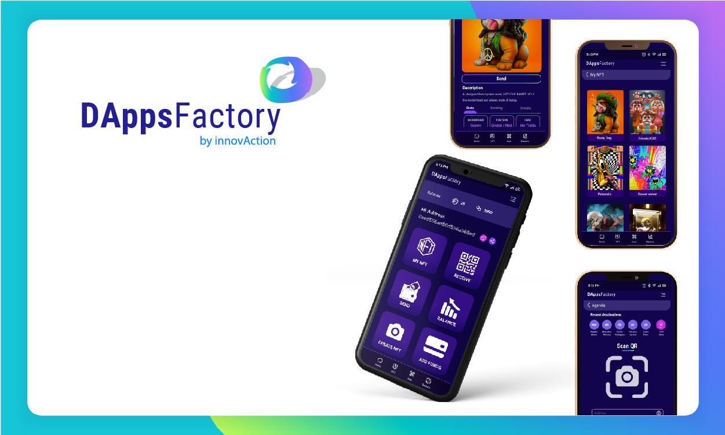
DEVELOPED
https://www.pieceofcakewallet.com/

Slide 16
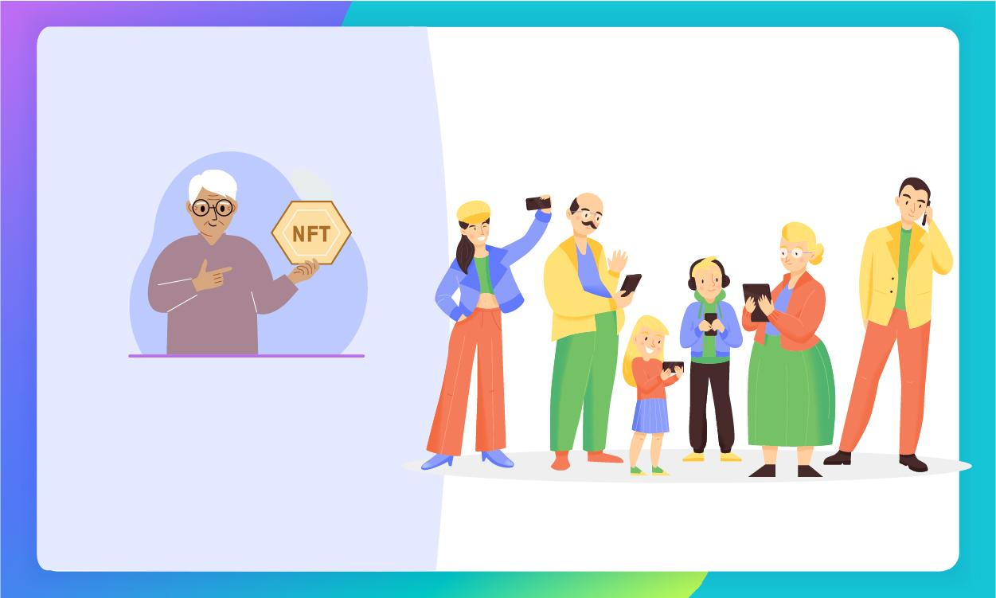
THE WALLET
SOLUTION FOR

Slide 17
BUSINESS MODEL:
GENERATE AN EASILY CUSTOMIZABLE WHITE-LABELED SAAS WALLET
For big brands that need to share NFTS.
For brands that need to viralize advertising based on value delivery.
For multimedia companies that share content
For metaverse companies (NFT revenue enabler)
For companies that generate user experiences, such as events and event participation
To easily generate entry to real events and Metaverse
For tourist experiences, memories of moments and places and sharing them.
"I WAS HERE " (I was here)
For proof of presence of Utility Companies services (Certifying Localition, Timestamping and Photography)
Gift Lists, you can buy NFTS

Slide 18
Three main sources of Monetization:
Creation and personalization for wallet branding
Revenue sharing for each transfer operation
Transfer, mining, sale
Fee porcentual de la venta en el Market Place
MONETIZATION

Slide 19
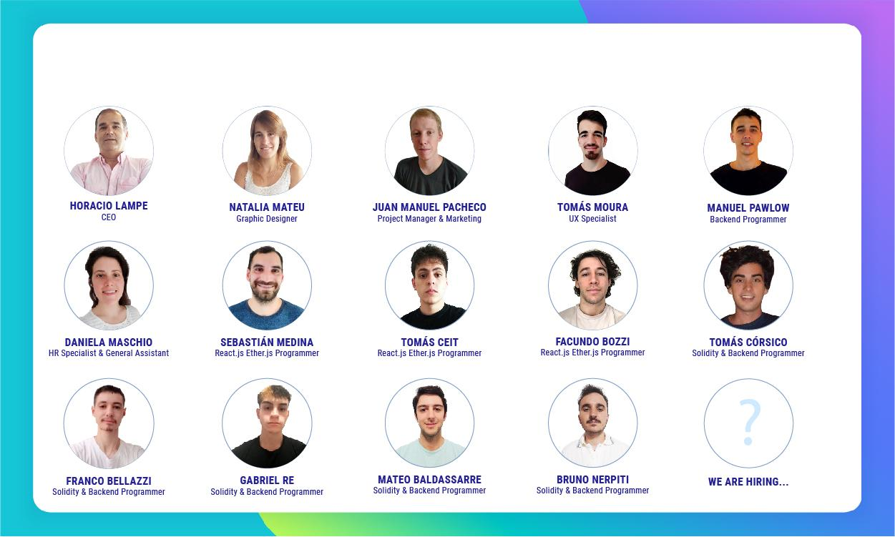
OUR TEAM
It is made up of a group of professionals with experience in IT business areas.

Slide 20
THANK YOU !

